Slide 1


Slide 2
Introduce
https://facebook.github.io/react/tutorial/tutorial.html
React is a declarative, efficient, and flexible JavaScript library
for building user interfaces.
Declarative
Component-Based
Learn Once, Write Anywhere
1.Learn JavaScript
2.Learn component
Notes:
https://github.com/ruanyf/jstraining/blob/master/docs/react.md

Slide 3
Basic
React
React-router
Redux
Antd
https://github.com/facebookincubator/create-react-app

Slide 4
Other
1) Server Rendering
2)Flow
3)Storybook(Test)
4)React Native
5)Mobx
6)Grapql
7)React VR
8)Dva…

Slide 5
Most used JavaScript Feature
1)Import,Export
2)Const,let变量声明
3)析构赋值
4)箭头函数
5)Spread Operator（…）
6)Map,Filter,Reduce
7)模板字符串
Notes:
https://github.com/dvajs/dva-knowledgemap

Slide 6
Component Class
Create Way
1)Component
2)Stateless Component
UI
1)Container Component
2)Presentation Component
Form
1)Controlled/Un Controlled Component
Smart/Stupid HOC
Notes:
http://www.cnblogs.com/wonyun/p/5930333.html

Slide 7
JSX
1)One root element
2){} run js
3)ClassName
Props
State
Render
View=func(State)

Slide 8
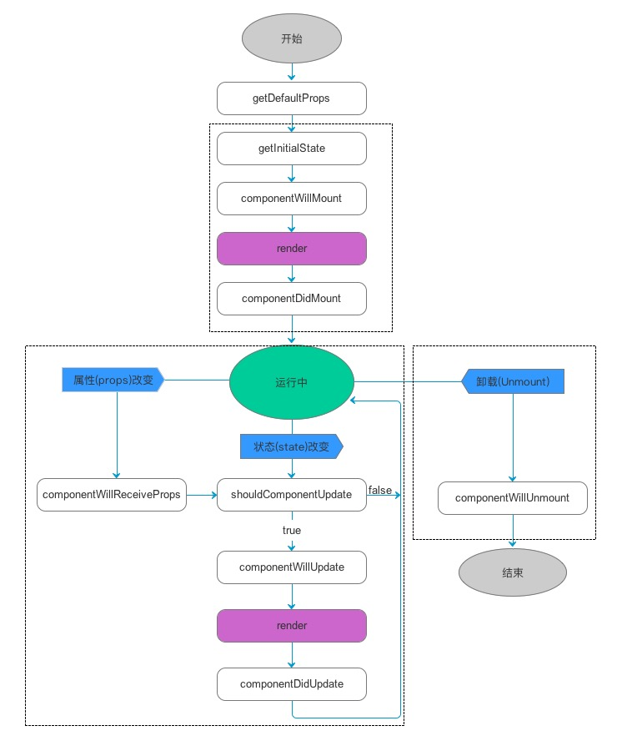
Life cycle
https://facebook.github.io/react/docs/react-component.html
Notes:
https://github.com/hhhyaaon/react-lifecycle-demo/blob/master/src/views/index.js
Constructor
Render

Slide 9
Life cycle
https://facebook.github.io/react/docs/react-component.html

Slide 10
Conditional Rendering/Lists and Keys
https://facebook.github.io/react/docs/conditional-rendering.html
1)if (isLoggedIn) { return <UserGreeting />; }
Else{ return <GuestGreeting />;}
2)isXXX? A :B
3){(){if else}()
const numbers = [1, 2, 3, 4, 5];
const listItems = numbers.map((number) => <li>{number}</li> );

Slide 11
Data flow
1)Parent->Child
Prop
2)Child->Parent
Event
Ref，Context

Slide 12
Axios
this.axios.get(api).then((response) => {
console.log(response.data)
}

Slide 13
Router
https://github.com/ReactTraining/react-router/tree/v3/docs
Config:{ path: '/foo', component: Foo }
Use:1. <Link to="/foo">Go to Foo</Link>
2. browerHistory.push(‘/foo')
Histories Mode
withRouter HoC

Slide 14
Mixin
A mixin object can contain any component options.
When a component uses a mixin, all options in the mixin will be “mixed” into the component’s own options.
// define a mixin object
var myMixin = {
created: function () {
this.hello()
},
methods: {
hello: function () {
console.log('hello from mixin!')
}
}
}
// define a component that uses this mixin
var Component = Vue.extend({
mixins: [myMixin]
})

Slide 15
High Order Component
High Order
High Order
Mix Component
Mix Component
Basic Component1
Basic Component2
Basic Component3
Basic Component4

Slide 16
High Order Component-2 way create
1)Child Class
2)AOP
Notes:
组合优于继承

Slide 17
What is state?
1.Control visibility of one part’s element
2.Need display data(Object,Array)
Any js types…
Notes:
http://www.jianshu.com/p/c6257cbef1b1

Slide 18

State management
Three Principles
1. Single source of truth
2. State is read-only
3. Changes are made with pure functions
Notes:
nextState=func（oldState，action）
Action，reducer，store
https://github.com/mocheng/react-and-redux

Slide 19
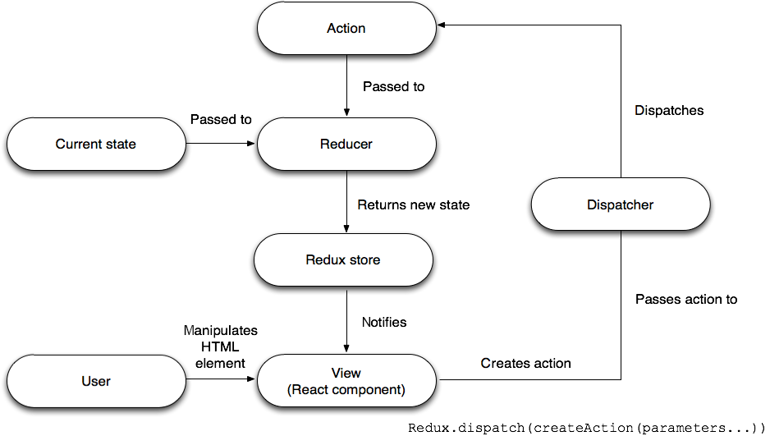
State management(Redux)
Notes:
https://segmentfault.com/a/1190000006966262

Slide 20
React 16
1.Fiber architecture
2. New render return types: fragments and strings
3. Better error handling
4. Portals
5. Better server-side rendering
6. Support for custom DOM attributes

Slide 21
Thank you!
(study hard, play hard)

